Slide 1
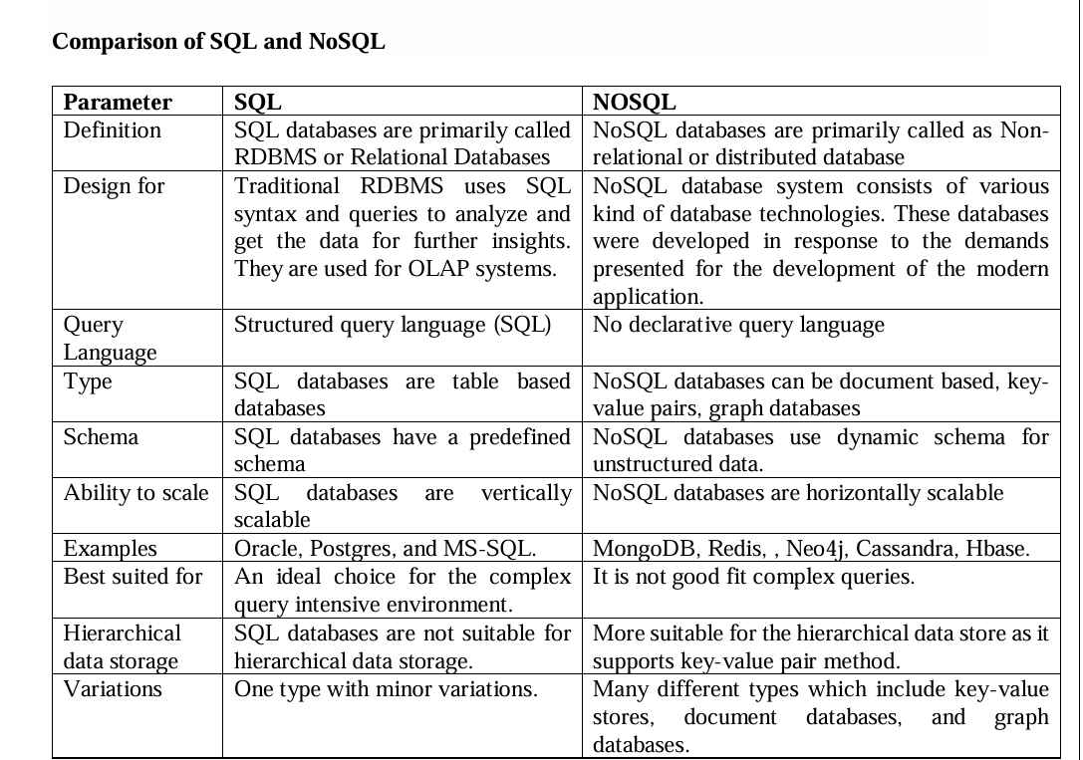
COMPARISON SQL AND NOSQL

Slide 2
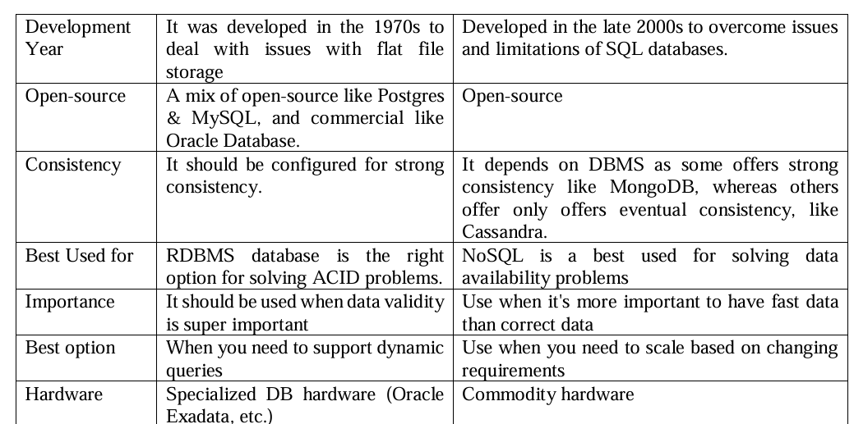

Slide 3
